Slide 2
Notes:
1. KEY PRINCIPLES > Review DOMINANCE, EYEFLOW, CONTRAST from the definitions provided on the screen.

Slide 3
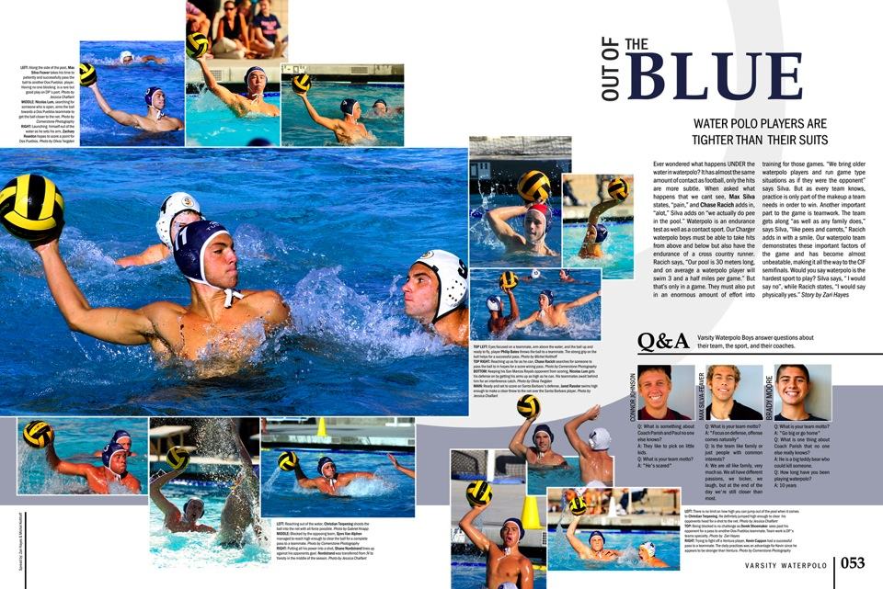
DOS PUEBLOS HIGH SCHOOL [CA]
Notes:
1 > KEY PRINCIPLES
DOMINANCE: One photo is clearly larger than every other photo on this spread. The dominant photo plays an important role as the center of visual interest –- pulling readers into the design.
EYELFLOW: When placing elements, especially photographs, on the spread consider how they direct the eye movement. In this case, the dominant photo directs the reader into the center of the spread and into the secondary photos and the headline/story presentation.
CONTRAST: A variety of modular sizes and shapes are used for variety. And, a partial cut-out-background photo adds contrast without overpowering with the dominant photo.

Slide 4
Notes:
2. DESIGN ELEMENTS > Review VISUAL, VERBAL, STORYTELLING from the definitions provided on the screen.

Slide 5
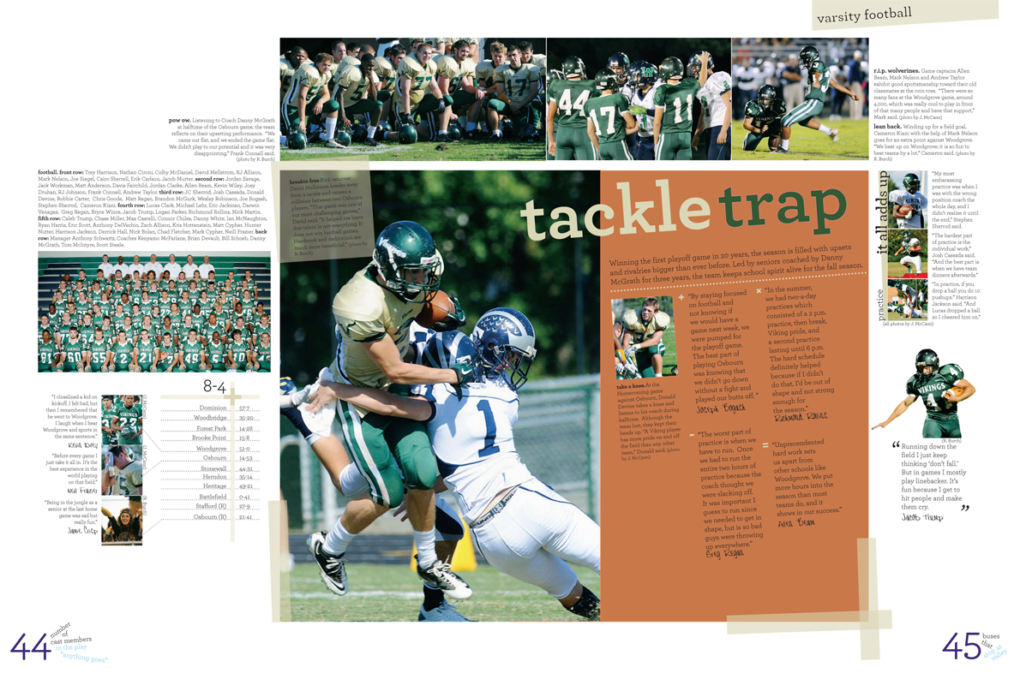
LOUDOUN VALLEY HIGH SCHOOL [VA]
Notes:
2 > DESIGN ELEMENTS
VISUAL: A wide variety of photographs are used in varying sizes. An action photograph is used for the dominant. Additional smaller photos are used to further tell the story without overpowering the dominant. A group shot of the team is used for reference, but is not the largest photo on the spread. A cut-out-background photo is used to contrast the modular shapes.
VERBAL: The main story presentation includes a primary headline with a detailed secondary headline and four expanded quotes. Detailed story captions are used throughout. A scoreboard provides a complete record of the season and direct quotes from the players add a human voice to the coverage.

Slide 6
Notes:
3. THE FRAMEWORK > Review FRAMING MARGIN, GUTTER, GRIDS/COLUMNS from the definitions provided on the screen.

Slide 7
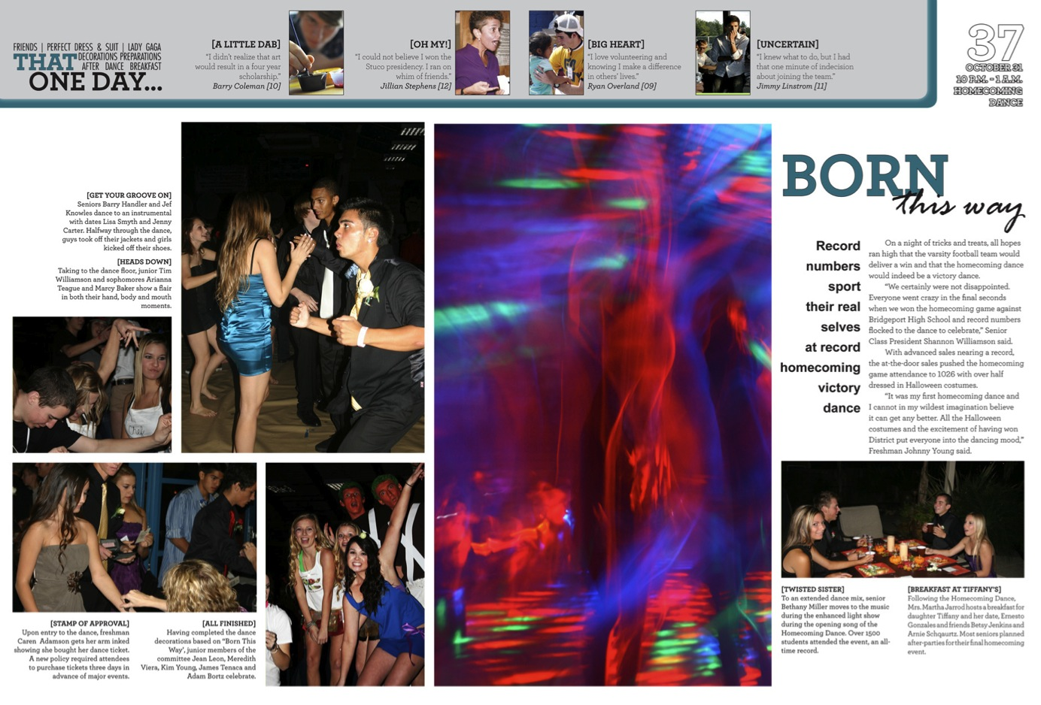
Notes:
3 > THE FRAMEWORK
FRAMING MARGIN: Acts like a picture frame around the spread, giving the content room to breath. Text should not extend into the framing margin. Bleed photos may cross through the framing margin and extend to the page edge.
GUTTER: The area in the center of the spread where the yearbook is bound and glued together. For a dynamic design, the pages should be designed as a visual unit. Photos may cross the gutter, if care is taken not to have faces or important action fall in the gutter. For best results, larger photos are best for crossing the gutter.
GRIDS/COLUMNS: By dividing the spread into vertical columns/grids, the designer is able to effectively organize the content. The narrower the columns/grids, the more flexibility they afford the designer.

Slide 8
Notes:
3 > THE FRAMEWORK
FRAMING MARGIN: Acts like a picture frame around the spread, giving the content room to breath. Text should not extend into the framing margin. Bleed photos may cross through the framing margin and extend to the page edge.
GUTTER: The area in the center of the spread where the yearbook is bound and glued together. For a dynamic design, the pages should be designed as a visual unit. Photos may cross the gutter, if care is taken not to have faces or important action fall in the gutter. For best results, larger photos are best for crossing the gutter.
GRIDS/COLUMNS: By dividing the spread into vertical columns/grids, the designer is able to effectively organize the content. The narrower the columns/grids, the more flexibility they afford the designer.

Slide 9
Notes:
4. START TO FINISH > Review DOMINANT MODULE, SECONDARY MODULES, SPACE from the definitions provided on the screen.

Slide 10
Notes:
4 > START TO FINISH
DOMINANT MODULE: This always the largest module and is the focal point of the spread. Because it is the largest, the dominant module should present the most important content on the spread.
SECONDARY MODULES: Present different angles or perspectives on the topic covered on the spread. Secondary modules should be smaller than the dominant and offer a variety of coverage approaches.
SPACE: There are three levels of spacing. Tight spacing is used within the modules to unify the content. Expanded spacing is used between the different modules to separate them. Standard spacing is the traditional one-pica spacing that is used as a default on the design.

Slide 11
Notes:
5. READABILITY > Review GRAPHICS, STRATEGIC, REPETITION from the definitions provided on the screen.

Slide 12
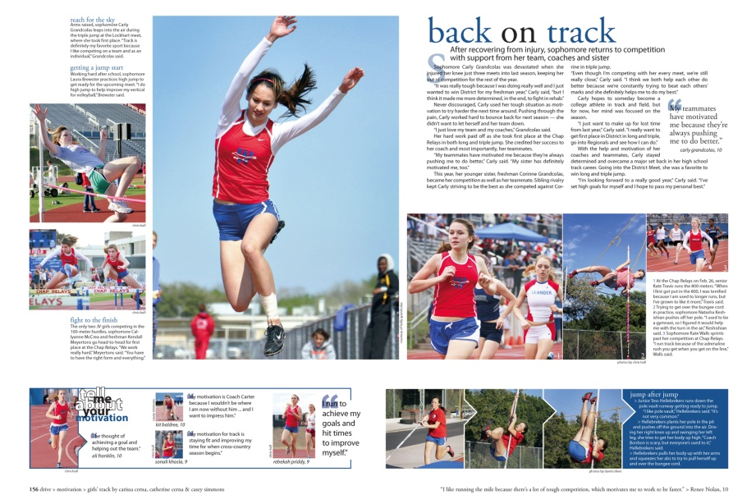
WESTLAKE HIGH SCHOOL [TX]
Notes:
5 > READABILITY
GRAPHICS: Blue accent color unifies the design. Lines unify the content module on the left. Blue is used to accent the content module on the right.
STRATEGIC: Graphics are used for a purpose. The lines on the left form a box that unifies content.
REPETITION: Blue is echoed across the spread for unity without overpowering the content.

Slide 13
Notes:
> QUESTIONS
What questions do you have? Please raise your hands.

